Slide 1
Instruction ExecutionCycle

Slide 2
A program residing in the memory unit of the computer consists of a sequence of instructions.
The program is executed in the computer by going through a cycle for each instruction.
The processing required for a single instruction is called an instruction cycle.
In the basic computer each instruction cycle consists of the following phases:
1. Fetch an instruction from memory.
2. Decode the instruction.
3. Read the effective address from memory if the instruction has an indirect
address.
4. Execute the instruction.
Upon the completion of step 4, the control goes back to step 1 to fetch, decode,
and execute the next instruction. This process continues indefinitely unless a
HALT instruction is encountered.

Slide 4
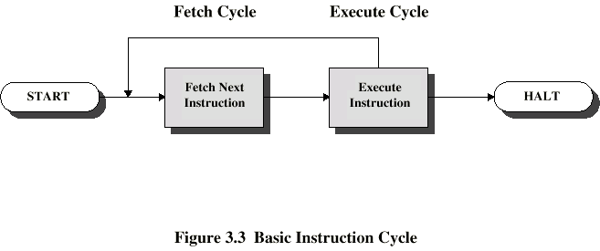
Basic Instruction Cycle

Slide 5
Fetch Cycle
Program Counter (PC) holds address of next instruction to fetch
Processor fetches instruction from memory location pointed to by PC
Increment PC
Instruction loaded into Instruction Register (IR)
Processor interprets instruction and performs required actions
Execute Cycle:
Processor-memory
data transfer between CPU and main memory
Processor I/O
Data transfer between CPU and I/O module
Data processing
Some arithmetic or logical operation on data
Control
Alteration of sequence of operations
e.g. jump

Slide 6
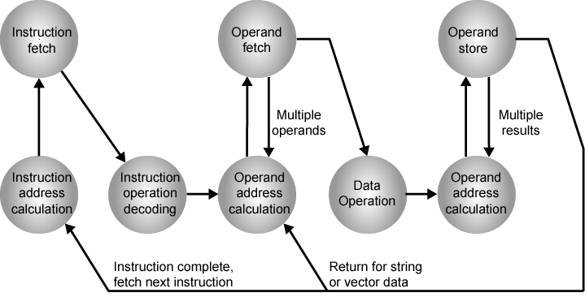
Instruction Cycle State Diagram

Slide 7
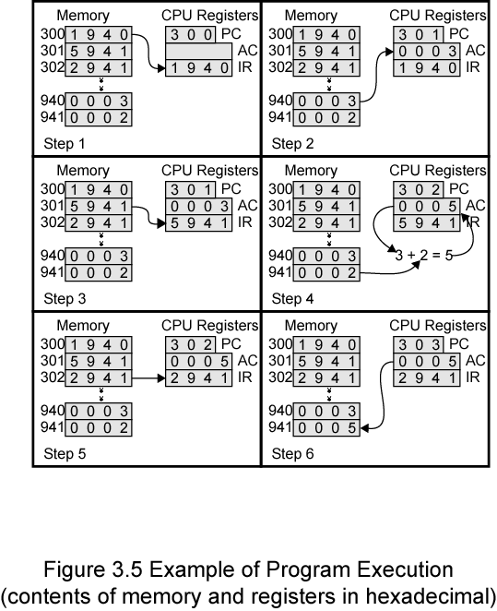
Example of Program Execution

Slide 9
Fetch And Decode
The microoperations for the fetch and decode phases can be specified by the
following register transfer statements.
T0: AR <- PC
T1: IR <-M[AR], PC <- PC + 1
T2: D0, • • • , D7 <- Decode IR(12-14), AR <--- IR(0-11), I <--- IR(15)
T1: IR <-M[AR], PC <- PC + 1

